Slide 1
Software Development 3
Exception Handling

Slide 2
What is an Exception?
A program may encounter problems as it executes
Java Errors and Exceptions enable programs to deal with such problems
Programs can recover from errors and keep on running
Important in commercial programming
Java throws Exception objects to indicate a problem

Slide 3
What Do Exceptions Do?
The exception-handling capability of Java makes it possible for you to:
  Monitor for exceptional conditions within your program
  Transfer control to special exception-handling code which you design if an exceptional condition occurs
  This is accomplished using four keywords: try, throw, catch and finally.

Slide 4
Exceptions
You try to execute the statements contained within a block surrounded by braces
If you detect an exceptional condition within that block, you throw an exception object of a specific type (i.e the person enters the wrong data/username/password)
You then catch and process the exception object using code that you have designed
catch (EOFException e){
} (i.e EOF = end of file exception)
In Java, you can then optionally execute a block of code designated by finally which is normally used to perform some type of cleanup which is needed whether or not an exception occurs

Slide 5
Why use exceptions?
Forces error checking
Cleans up your code by separating the normal case from the exceptional case
The code isn't littered with a lot of if-else blocks checking return values.
Traditional programming languages set flags or return bad values like -1 to indicate problems. Programmers often don't check these values.

Slide 6
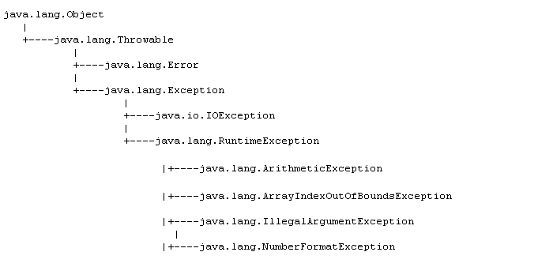
The Throwable class hierarchy
All the standard exceptions are covered by two direct
subclasses of the class Throwable
    the class Error
    the class Exception
An exception is always an object of some class Throwable

Slide 7
The Throwable class
The Throwable class has two subclasses:
  Exception
    An exception (small 'e') is a problem that occurs when a program is running. A program may have statements that catch exceptions. When an exception occurs, the Java virtual machine creates an object of class Exception (big 'E') which holds information about the problem.
    There are nine subclasses of the Exception class several of which have numerous subclasses.
  Error
    An Error, also, is a problem that occurs when a program is running. An error is represented by an object of class Error. But an error is too severe for a program to handle. The program must stop running. E.g. Out of memory error

Slide 8
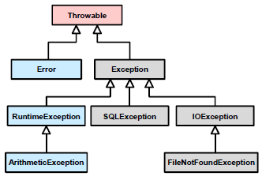
Exception Categories
The java.lang.throwable class forms the basis of the hiercarchy of exception classes. There are two main categories of exception classes:
  Checked Exceptions must be “handled or declared”
  UnChecked Exceptions which are not typically “handled or declared”
  grey = Checked
  blue = unChecked

Slide 9
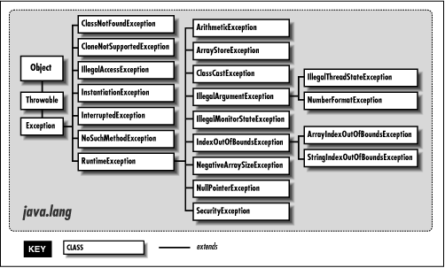
Exception Hierarchy

Slide 10
Example: RuntimeException
One subclass of Exception is the class named RuntimeException This class has eleven subclasses, some of which are further subclassed.
All exceptions other than those in the RuntimeException class must be either:
      caught, or
      declared in a throws clause of any method that can throw them.
RuntimeException exceptions are ignored by the compiler as they generally arise because of serious errors in your code.

Slide 11
Example: RuntimeException
Example Runtime Exception Classes
  ArithmeticException (i.e. divide by zero)
  NegativeArraySizeException (i.e. you define an Array with a negative dimension)
  NullPointerException (i.e. Object reference contains null when it should reference an actual object for data or to run a method)
  IndexOutOfBoundsException(i.e. You are trying to index an Array element or a String element which doesn't exist)
  IllegalArgumentMethod (i.e. You've passed an argument to a method that is of the wrong data type)

Slide 12
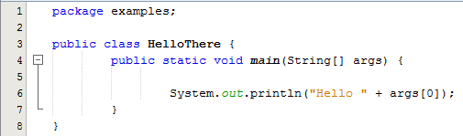

Example 1
This program is executed.
Notice that there is no args[0].
Here's the runtime exception that you get.
This is not a crash, it is an exception. The virtual machine exits normally. All memory is cleaned up. All resources are released.

Slide 13
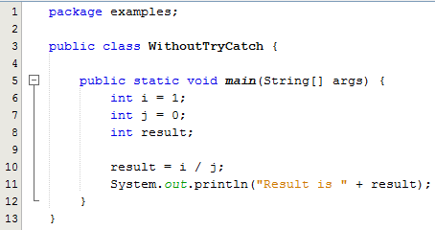

Example 2
The Class WithoutTryCatch shows an example of an ArithmeticException (a RuntimeException) being thrown
In this program we tried to divide by zero which threw an exception
We did not handle the exception so the program terminated

Slide 14
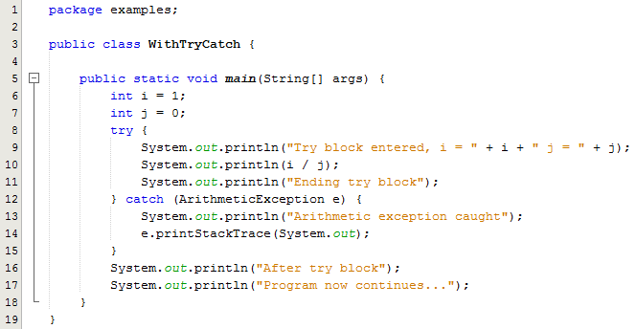
Example 3
This is a simple example of catching a divide by zero exception
The program can then continue

Slide 15

Example 3 - How the Program works
Program Output:
How the Program works:
The variable j is initialised to 0, so that the divide operation in the try block will throw an ArithmeticException exception. Java will not allow us explicitly divide by zero hence the use of variable j.
When the exception is thrown, control transfers to the first statement in the catch block at line 12. The statement at line 14 in the catch block is a call to the printStackTrace() method which prints this part of the above message:
java.lang.ArithmeticException: / by zero
at exceptionsex1.WithTryCatch.main(WithTryCatch.java:11)
Here we see the line number in the source code where the exception originated followed by a trace of the method calls that immediately preceded the point at which the exception occurred.

Slide 16
Some Syntax rules
The statements in the try{} block can include:
    Statements that always work.
    Statements that might throw an exception of one type or another.
There can be one or several catch{} blocks.
Each catch{} block describes the type of exception it handles. It will also catch subclasses of it.
The finally block will be executed whether an exception is thrown or not

Slide 17
Handling Exceptions
What Exceptions can't be handled?
  Those in java.lang.Error
If your code can throw exceptions other than those of type Error or type RuntimeException, you must do something about it.
When you write code that can throw an exception, you can do two things:
  supply code within the method to deal with the exception that is thrown
  ignore it by enabling the method containing the exception throwing code to pass it on to the code that called the method

Slide 18
Exercise
Create an array of integers and attempt to print the contents of element -1. This throws an ArrayIndexOutOfBoundsException.
The print command should be in a try block and the Exception should be caught in a catch block.
Include a String to be printed after the catch block has executed.
Using try and catch, deal with this exception and allow the progam to continue

Slide 19
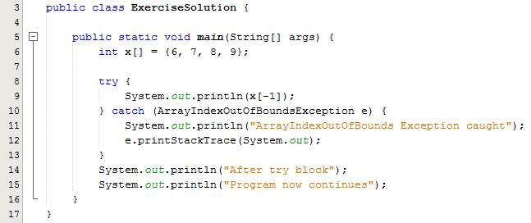

Exercise - Solution
Program Output

